Slide 1
Pecan Crop Decision Tree Analysis
By: Stephanie Benavidez

Slide 2
Introduction
According to Texas Agriculture, “Texas Pecans hold a special place in the hearts and kitchens across the state. Pecans are the only major tree nut truly native to the United States. Archaeologists have found evidence of pecan seed and leaf fossils formed along the Rio Grande dating as far back as 6100 B.C.
Today, Texas is a leading pecan grower and the top producer among states where the tree is native. It is no wonder that the pecan is recognized as the State Tree (pecan tree), the State Health nut (pecan nut), and the Texas State Pie (pecan pie) designations” (Miller, n.d.).

Slide 3
According to resent studies and research
Pecan can help prevent:
  Obesity
  Diabetes
  Inflammation
“Pecans, along with other nuts of similar composition, like walnuts and hazelnuts, are rich in polyunsaturated fats, dietary fiber, and polyphenols, substances known for their antioxidant and anti-inflammatory properties” (Curley, 2023). Pecans also have nutrients like “monounsaturated fats, vitamin E, and fiber” (Curley, 2023).

Slide 4
Data Source
Food and Agriculture Organization (FAO) of the United Nations (Food and Agriculture Organization, 2023).
Variable data will come from these sources within the FAO Website.
  Production – Crops and livestock products (Crops and Livestock Products Data, n.d.)
    Crop Yield – the amount produced per hectare.
    Area Harvested – number of hectares harvested.
  Climate Change Indicators – Temperature change on land (Temperature Change on Land Data, n.d.)
    Temperature Change – degrees Celsius of difference from the previous meteorological year.
  Prices – Producer Prices (Producer Prices Data, n.d.)
    Producer Price – the amount paid to growers when selling crops.
  Producer Price Trade – Crops and Livestock Products (Producer Price Trade Data - Crops and livestock products, n.d.)
    Export Value – total value of exported crop that year.
  SDG Indicators - SDG Indicators (SDG Indicators, n.d.)
    Level of Water Stress – the proportion of water withdrawn from available sources.

Slide 5
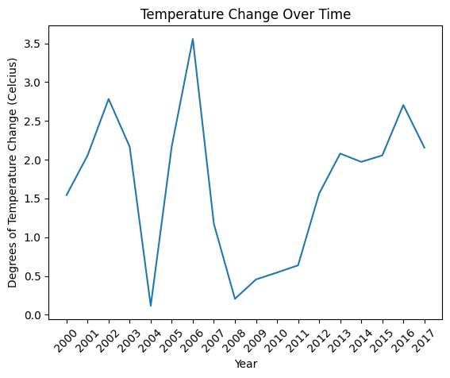
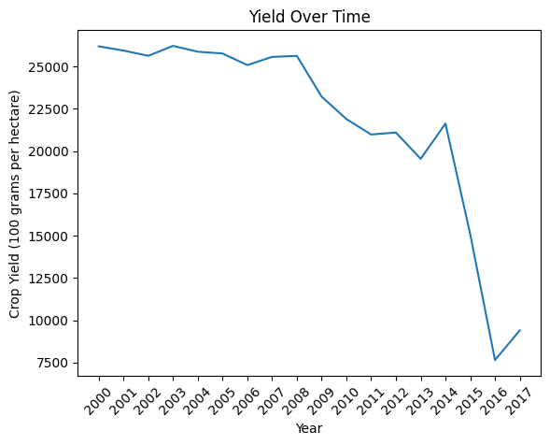
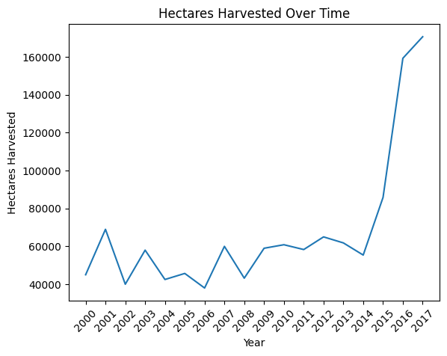
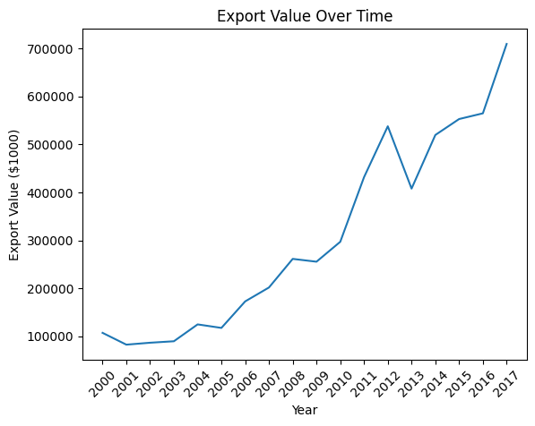
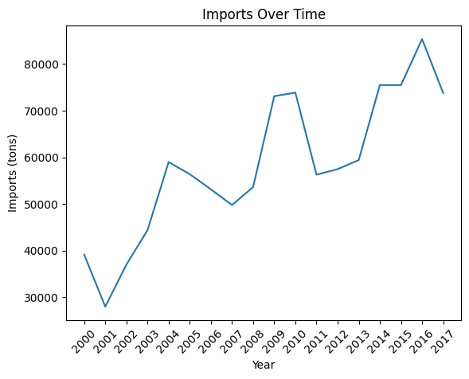
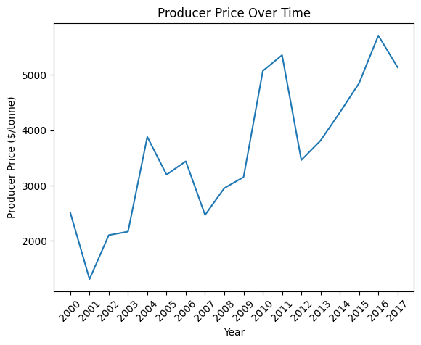
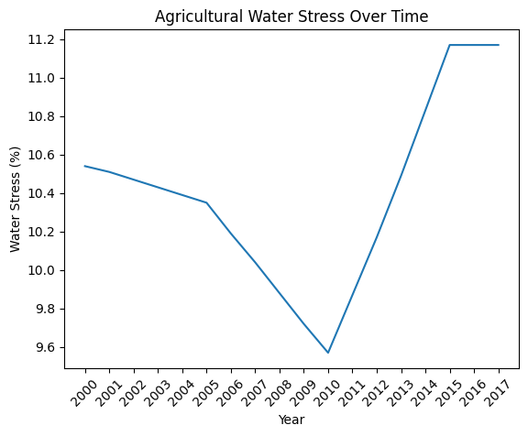
Graphic Analysis
Variable Trends Over Time

Slide 6
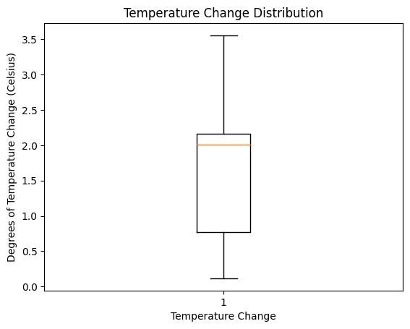
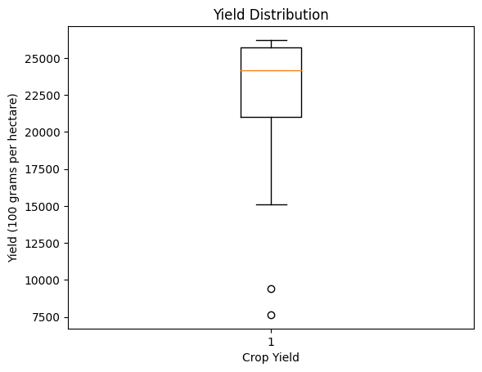
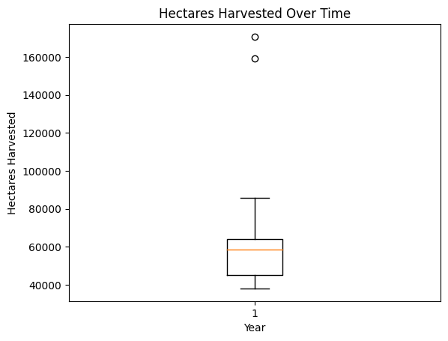
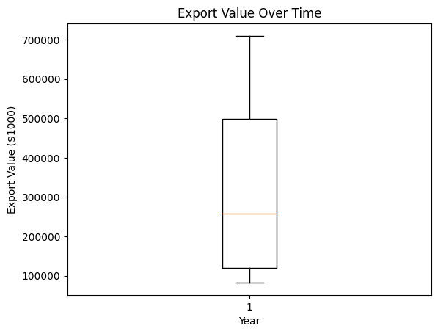
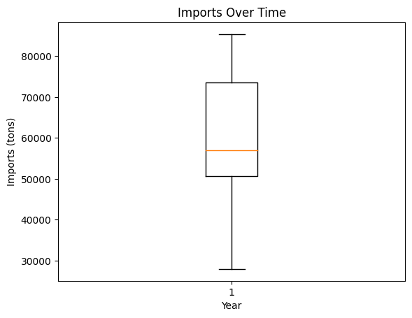
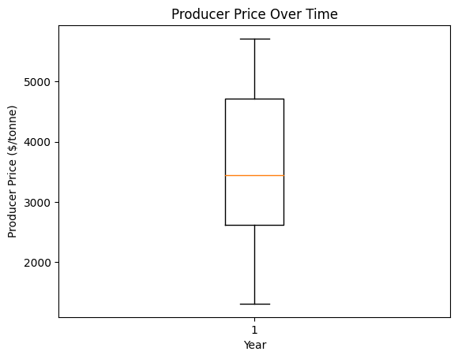
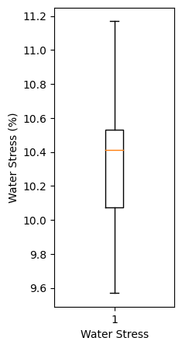
Examination of Outliers via Boxplots

Slide 7
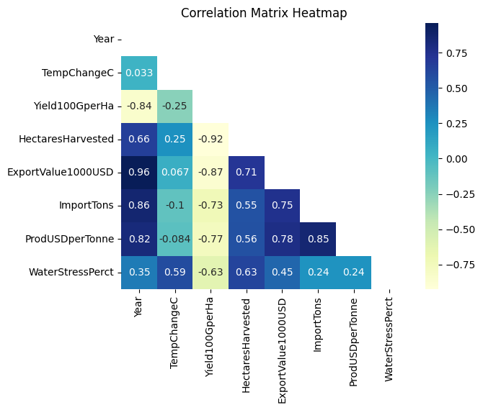
Correlation Matrix on Data

Slide 8
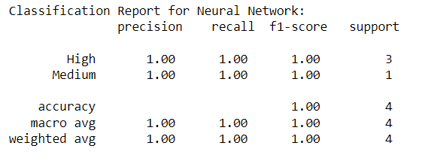
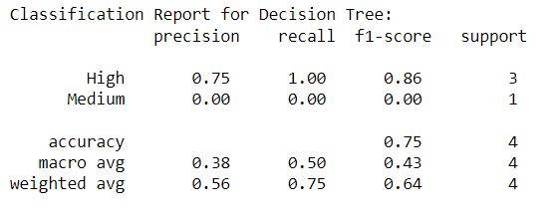
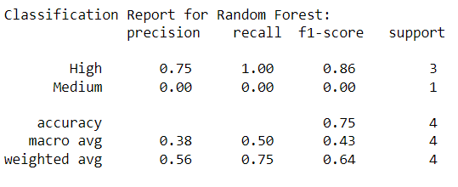
Classification Reports from each model
Neural Network
Random Forest
Decision Tree

Slide 9
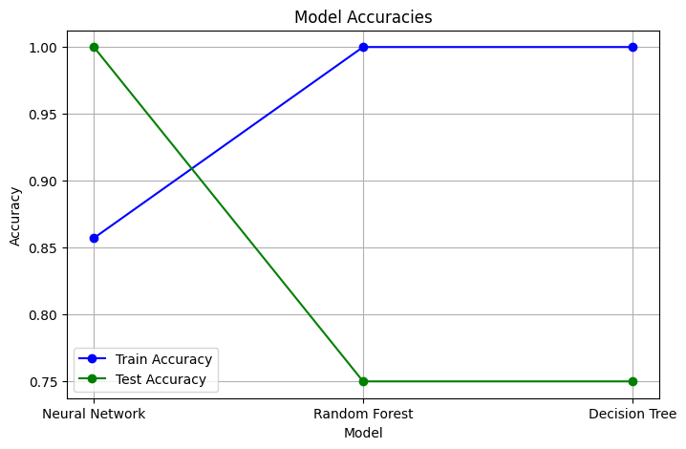
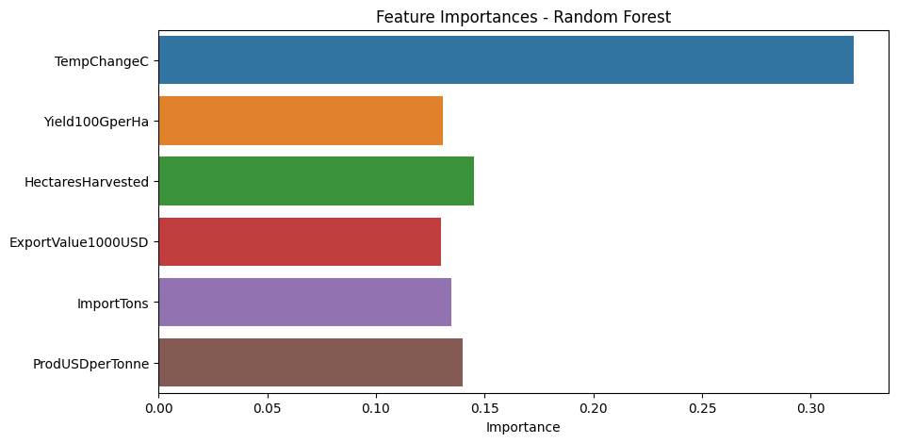
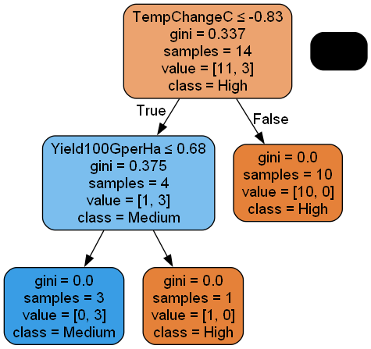
Other Visualizations

Slide 10
Research and Ethical Questions
Are pecan crop yields increasing or decreasing over time? After 2013 the crop yield seemed to decrease.
If costs have increased and cut into profit margins over time, are there examples of what caused these outliers? In this dataset, the Export Value, Imports, or Producer price did not show any outliers.
Do the temperatures show any effect on the trend lines within the project data timeline? Yes, you can see the fluctuations of the change.
What year had the highest crop yield for Pecans? From the year 2000-2008, the crop yield stayed steady before decreasing around 2008.

Slide 11
Questions cont.
What models will be used for this project? A Neural Network, Random Forest, and a Decision Tree Classifier.
Will the model be able to predict over 75%? If so, what models predicted over 75%? According to the accuracy plot, all three models had over 0.85 for the training dataset. For the test accuracy, only the Neural Network had over 75%.
Is there anything wrong with the data in the final CSV file? No.
Did it contain all the variables needed to reach the desires of the model’s analysis? I believe so.
Any issues finding a dataset suitable for this project? Yes, unfortunately, the dataset was based on other tree nuts since there were no datasets available focused on pecans.
Is there anything that was tried, but couldn’t produce results? Yes, I was trying to get a better visualization of the dot graph from the Decision Tree Classifier, however, the coding kept giving me errors.

Slide 12
In Conclusion
Both Random Forest and Decision Tree models had higher results
In both importance and dot graph, “TempChangeC”, and “Yield100GperHa” had highest values.
In all three models had an accuracy score over 75%.

Slide 13
References
Climate Change Indicators: Weather and Climate. (2022, August 1). Retrieved from www.epa.gov: https://www.epa.gov/climate-indicators/weather-climate
Crops and Livestock Products Data. (n.d.). Retrieved from www.fao.org: https://www.fao.org/faostat/en/#data/QCL
Curley, C. (2023, 8 8). Pecans may have protective effects against obesity, and diabetes. Retrieved from https://www.medicalnewstoday.com: https://www.medicalnewstoday.com/articles/eating-pecans-may-prevent-obesity-diabetes
Food and Agriculture Organization. (2023). Retrieved from www.fao.org: https://www.fao.org/faostat/en/#data
Miller, C. S. (n.d.). Texas Pecans. Texas Heart. Retrieved from https://www.texasagriculture.gov: https://www.texasagriculture.gov/Grants-Services/Marketing-and-International-Trade/International/Buyers-and-Consumers/Pecans
Producer Price Trade Data - Crops and livestock products. (n.d.). Retrieved from www.fao.org: https://www.fao.org/faostat/en/#data/TCL
Producer Prices Data. (n.d.). Retrieved from www.fao.org: https://www.fao.org/faostat/en/#data/PP
SDG Indicators. (n.d.). Retrieved from www.fao.org: https://www.fao.org/faostat/en/#data/SDGB
Temperature Change on Land Data. (n.d.). Retrieved from www.fao.org: https://www.fao.org/faostat/en/#data/ET

